Slide 1
Lecture -3
Conditionals

Slide 2
We’ll Learn Today
Conditionals
If Statements
Ternary Conditions
Switch Statements
Exercise

Slide 3
Conditionals
This Chapter deals with the various methods that C can control the flow of logic in a program. Apart from slight syntactic variation they are similar to other languages.
As we have seen following logical operations exist in C:
==, !=, , &&.
One other operator is the unary - it takes only one argument - not !.
These operators are used in conjunction with the following statements.

Slide 4
The if Statement
The if statement has the same function as other languages. It has three basic forms:
if (expression)
statement
...or:
if (expression)
statement1
else
statement2
...or:
if (expression)
statement1
else if (expression)
statement2
else
statement3

Slide 5
The if Statement (con’t)
For example:-
int x,y,z,w;
main()
{
if (x>0)
{
z=w;
........
}
else
{
z=y;
........
}
}

Slide 6
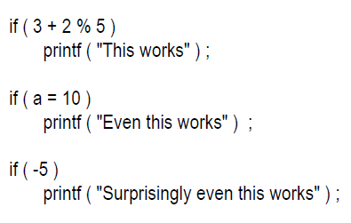
The Real Thing

Slide 7
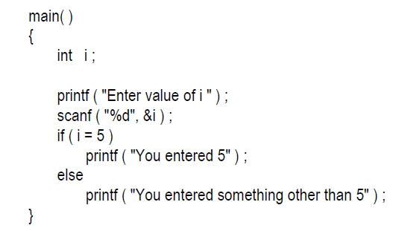
What is the Output of this program?

Slide 8
The ? Operator
The ? (ternary condition) operator is a more efficient form for expressing simple if statements. It has the following form:
expression1 ? expression2: expression3
It simply states:
if expression1 then expression2 else expression3

Slide 9
The ? Operator (con’t)
For example to assign the maximum of a and b to z:
z = (a>b) ? a : b;
which is the same as:
if (a>b)
z = a;
else
z=b;

Slide 10
The switch Statement
The C switch is similar to Pascal's case statement and it allows multiple choice of a selection of items at one level of a conditional where it is a far neater way of writing multiple if statements:
switch (expression) {
case item1:
statement1;
break;
case item2:
statement2;
break;
case itemn:
statementn;
break;
default:
statement;
break;
}

Slide 11

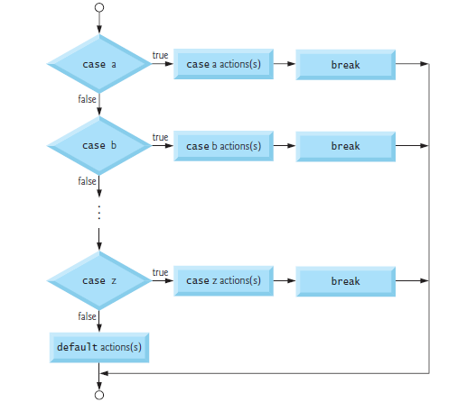
Flowchart of switch statements

Slide 12
The switch Statement (con’t)
In each case the value of item must be a constant, variables are not allowed.
The break is needed if you want to terminate the switch after execution of one choice. Otherwise the next case would get evaluated.
We can also have null statements by just including a : or let the switch statement fall through by omitting any statements (see e.g. next slide).

Slide 13
The switch Statement (con’t)
For example:-
switch (letter)
{
case `A':
case `E':
case `I':
case `O':
case `U':
numberofvowels++;
break;
case ` ':
numberofspaces++;
break;
default:
numberofconstants++;
break;
}

Slide 14
The switch Statement (con’t)
In the above example if the value of letter is `A', `E', `I', `O' or `U‘ then numberofvowels is incremented.
If the value of letter is ` ' then numberofspaces is incremented.
If none of these is true then the default condition is executed, that is numberofconstants is incremented.

Slide 15
The Tips and Traps
You can put the cases in any order you please.
If there are multiple statements to be executed in each case there is no need to enclose them within a pair of braces (unlike if, and else).
Not allowed:
  case i <= 20 :
  case 2.5:
  case a+b:
Legal expressions:
  switch ( i + j * k )
  switch ( 23 + 45 % 4 * k )
  switch ( a < 4 && b > 7 )

Slide 16
Class assignment
Marks: 02
Write a program which reads two integer values. If the first is less than the second, print the message up. If the second is less than the first, print the message down If the numbers are equal, print the message equal.exit( 0 ). [use switch case only]

Slide 17
Exercise
(Class Work)
Read an integer value. Assume it is the number of a month of the year; print out the name of that month.
Write a program which reads two integer values. If the first is less than the second, print the message up. If the second is less than the first, print the message down If the numbers are equal, print the message equal If there is an error reading the data, print a message containing the word Error and perform exit( 0 ).

Slide 18
Exercise
(Home Work)
If the ages of Wasim Akram, Javaid Miandad and Imran Khan are input through the keyboard, write a program to determine the youngest of the three.
Write a program to check whether a triangle is valid or not, when the three angles of the triangle are entered through the keyboard. A triangle is valid if the sum of all the three angles is equal to 180 degrees.

